Slide 1
MolSim WS 23/24
Sheet 5
Membranes, Parallelization, Contest No.2,
Nano-scale flow and Crystallization of Argon
Group C [Manuel, Tobias, Daniel]
02.02.2024

Slide 2
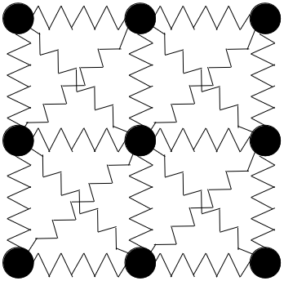
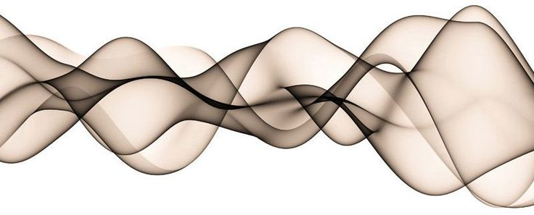
Simulation of a membrane
Harmonic Force
⇒ save neighbors for each particle
⇒ save spring constant k
The temporary force
⇒ acts on selected set of particles
⇒ acts for a specified amount of time
No Outflow boundaries

Slide 3
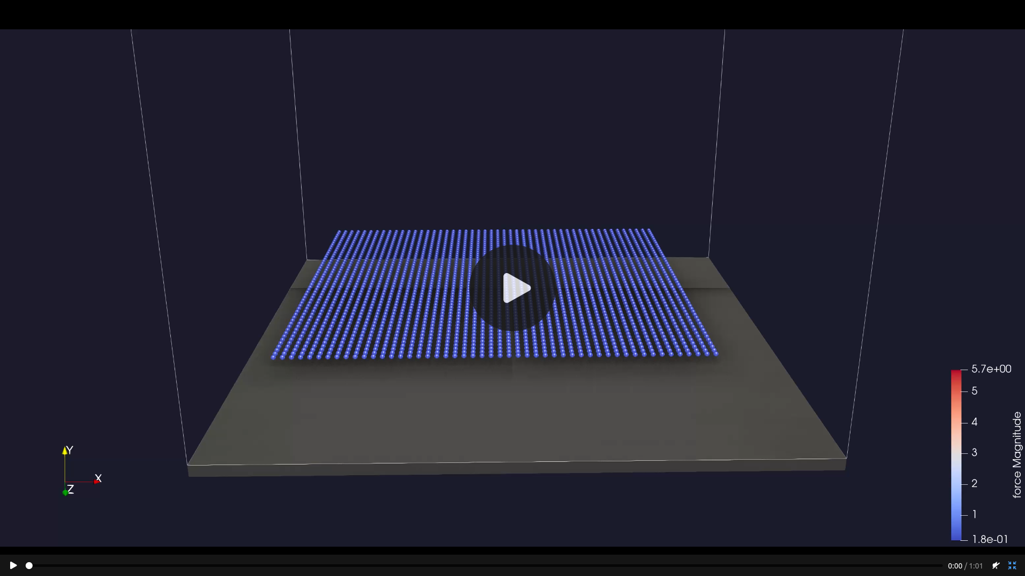
Simulation of a membrane
Full Video at:
https://manuellerchner.github.io/MolSim-WS23-24/submissions/#sheet05

Slide 4
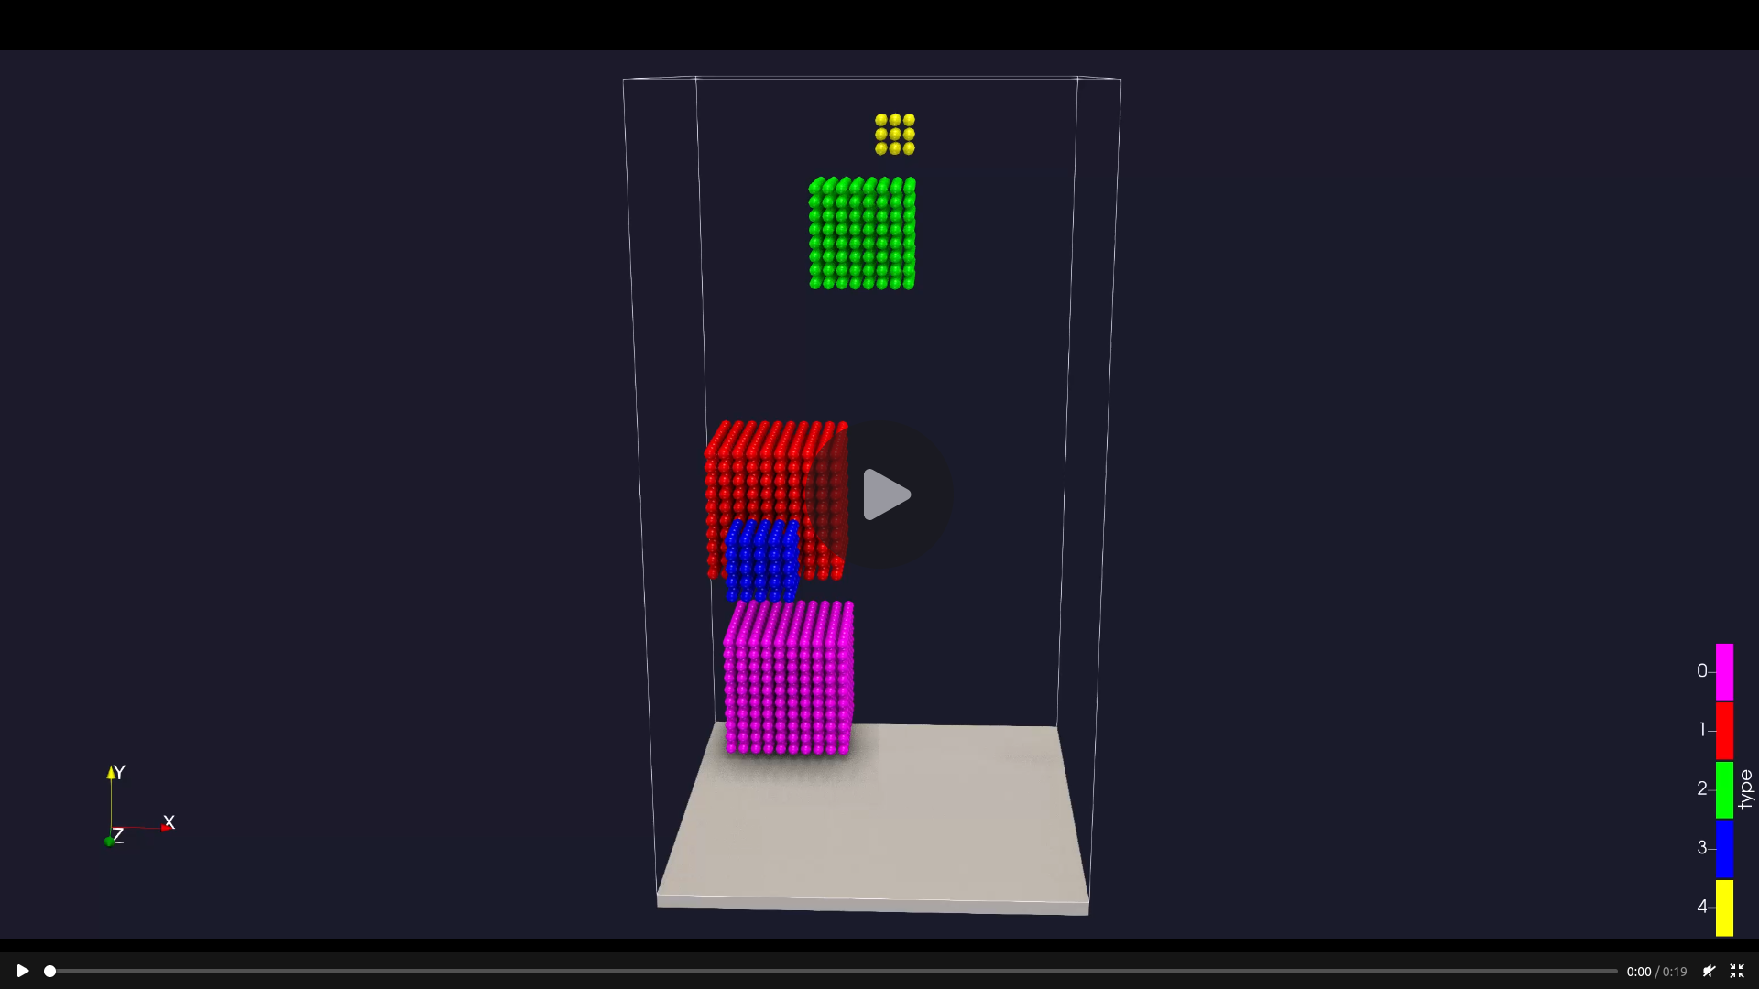
Simulation of a membrane
Full Video at:
https://manuellerchner.github.io/MolSim-WS23-24/submissions/#sheet05

Slide 5
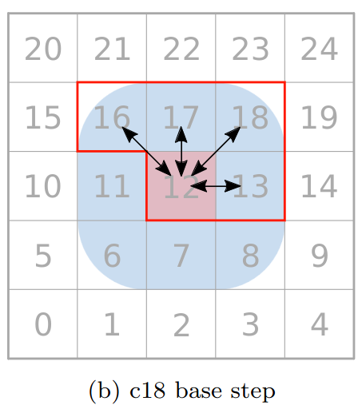
Parallelization
Domain Partitioning
Domain partitioning:
Parallelization works on a linearized queue of list of Cells
⇒ this queue differentiates the 2 methods
All members of 1 list can be worked on in parallel without race conditions
⇒ deterministic result

Slide 6
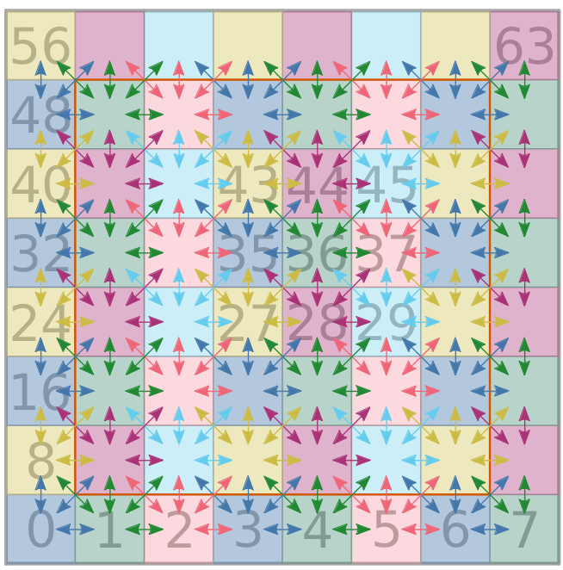
Parallelization
Domain Partitioning
Domain partitioning:
Parallelization works on a linearized queue of list of Cells
⇒ this queue differentiates the 2 methods
All members of 1 list can be worked on in parallel without race conditions
⇒ deterministic result
⇒ faster than second method

Slide 7
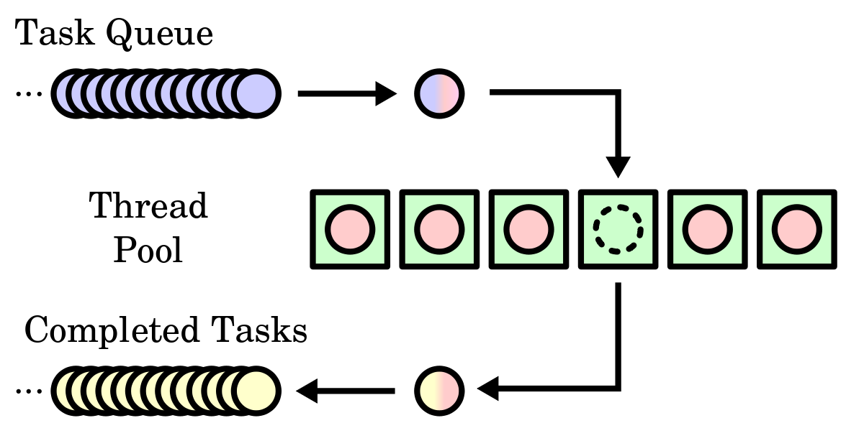
Parallelization
Particle Locking
Particle Locking:
Mutexes on the level of particles
The list of cells in our queue is sorted randomly
⇒ very little idle time in big examples because of randomization
⇒ not deterministic
⇒ order of calculation matters a lot in chaotic systems

Slide 8
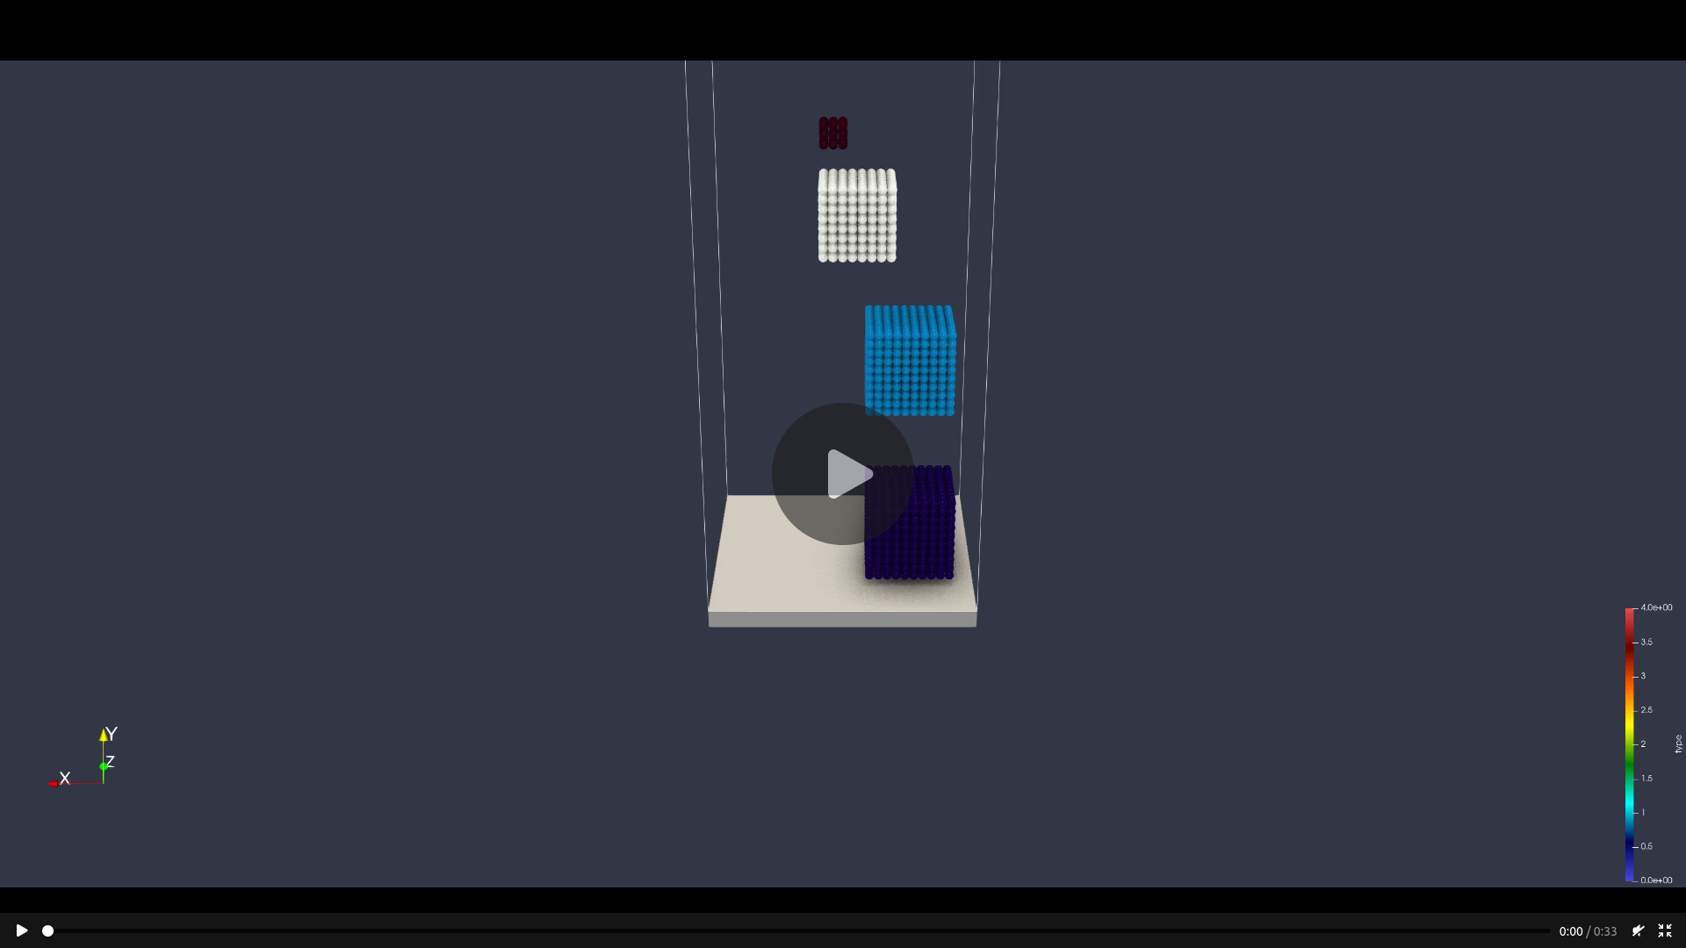
Parallelization
Particle Locking
Full Video at:
https://manuellerchner.github.io/MolSim-WS23-24/submissions/#sheet05

Slide 9
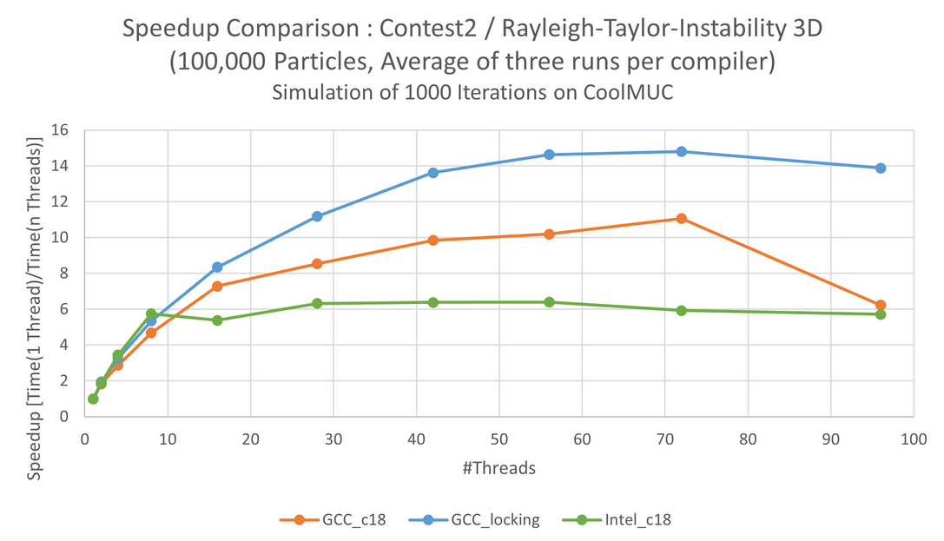
Performance: Speedup

Slide 10
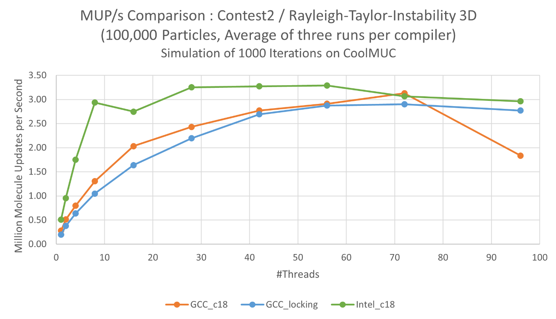
Performance: MUP/s

Slide 11
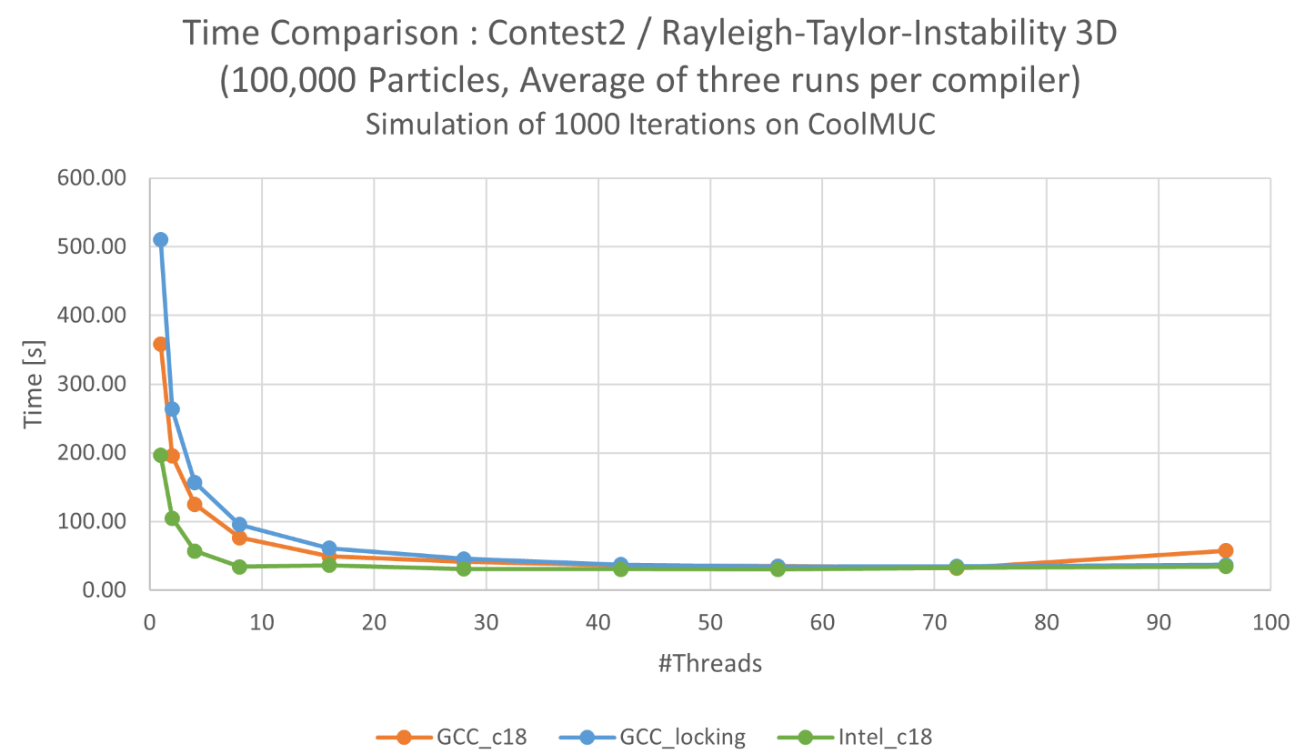
Performance: Time

Slide 12
Contest 2: Rayleigh-Taylor-Instability
Remarks:
42 is the optimal amount of threads (obviously)
Intel compiler has the best performance
Data:
27.323 seconds
3 659 920 MUP/s
⇒ 7x Speedup

Slide 13
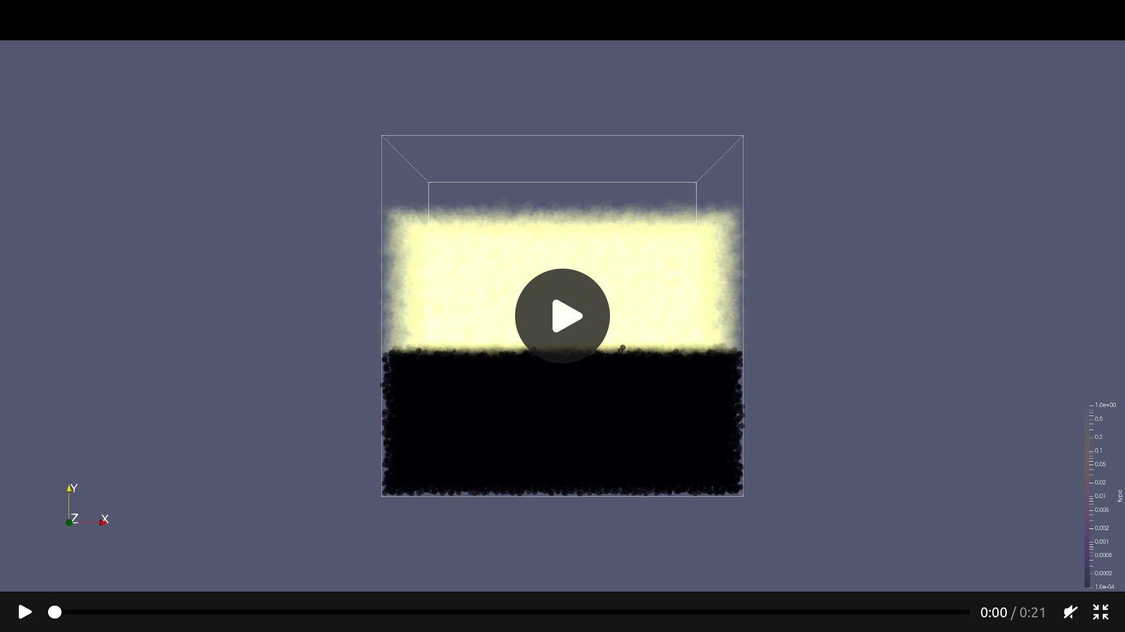
Contest 2: Rayleigh-Taylor-Instability
Full Video at:
https://manuellerchner.github.io/MolSim-WS23-24/submissions/#sheet05

Slide 14

Nano-scale flow simulation
1
New features:
Fixed flag for particles
New thermostat interceptor
Simulations:
Unhindered flow
Cuboid obstacle
Spherical obstacle
High velocity
Full Video at:
https://manuellerchner.github.io/MolSim-WS23-24/submissions/#sheet05

Slide 15
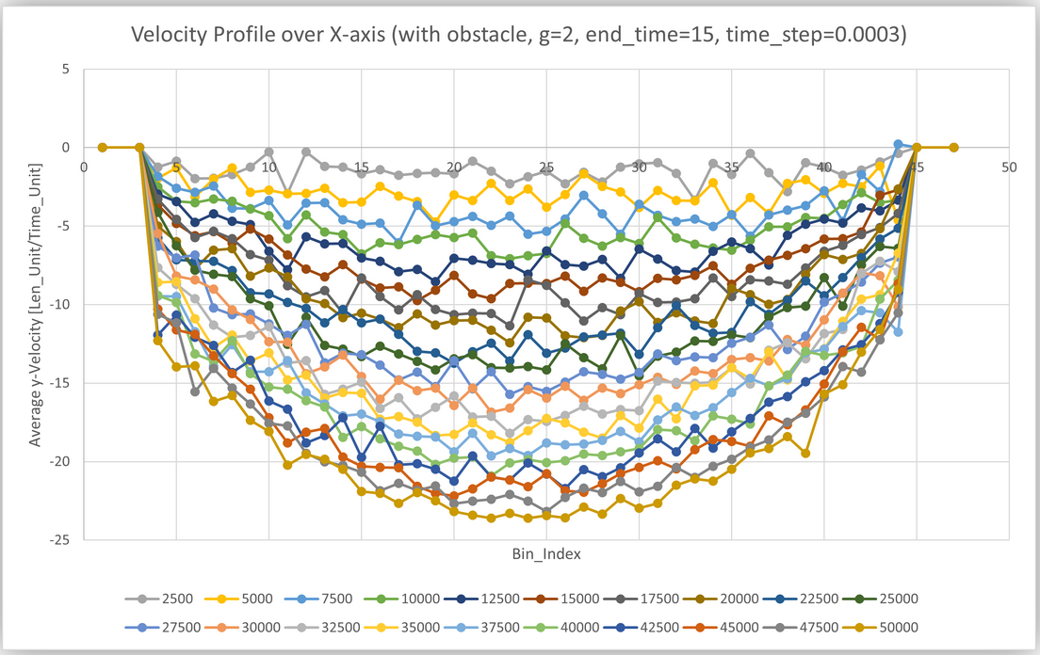
Nano-scale flow simulation
1
New features:
Fixed flag for particles
New thermostat interceptor
Simulations:
Unhindered flow
Cuboid obstacle
Spherical obstacle
High velocity

Slide 16
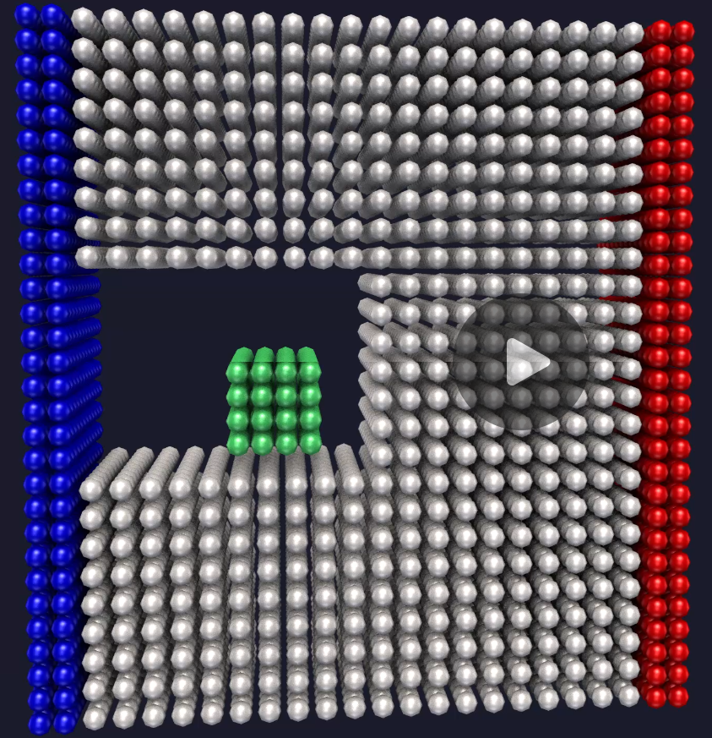
Nano-scale flow simulation
2
New features:
Fixed flag for particles
New thermostat interceptor
Simulations:
Unhindered flow
Cuboid obstacle
Spherical obstacle
High velocity
Full Video at:
https://manuellerchner.github.io/MolSim-WS23-24/submissions/#sheet05

Slide 17
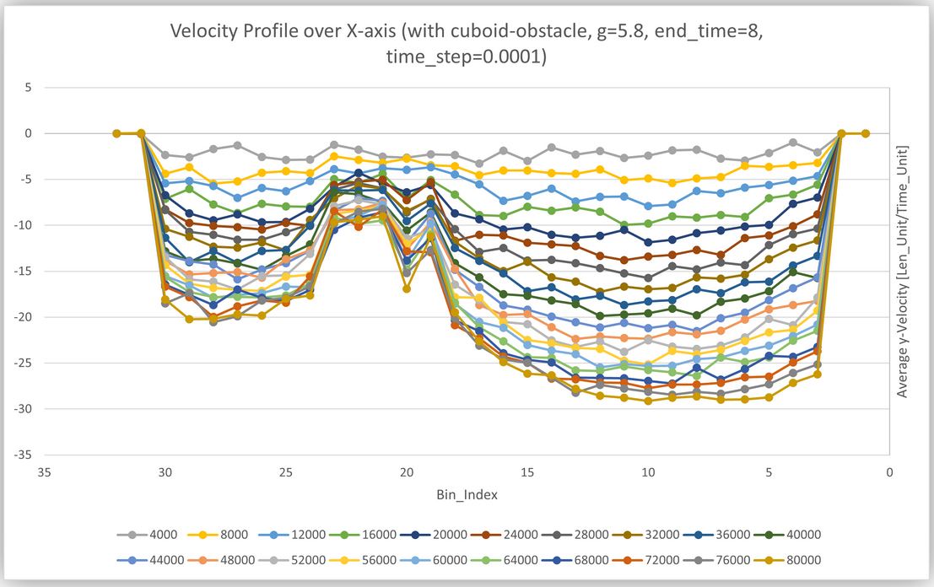
Nano-scale flow simulation
2
New features:
Fixed flag for particles
New thermostat interceptor
Simulations:
Unhindered flow
Cuboid obstacle
Spherical obstacle
High velocity

Slide 18
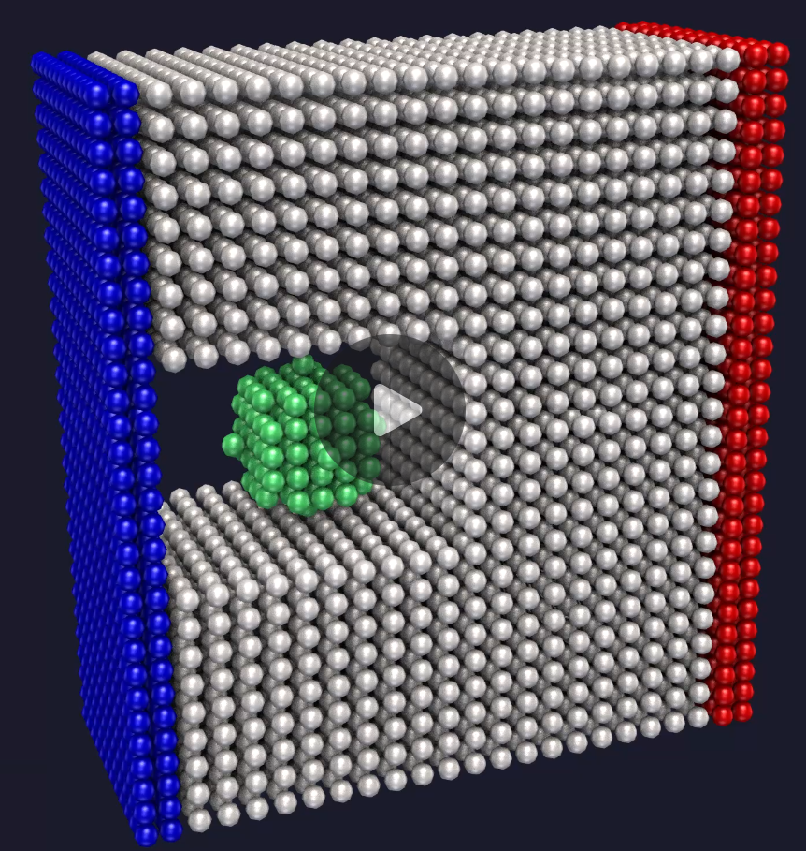
Nano-scale flow simulation
3
New features:
Fixed flag for particles
New thermostat interceptor
Simulations:
Unhindered flow
Cuboid obstacle
Spherical obstacle
High velocity
Full Video at:
https://manuellerchner.github.io/MolSim-WS23-24/submissions/#sheet05

Slide 19
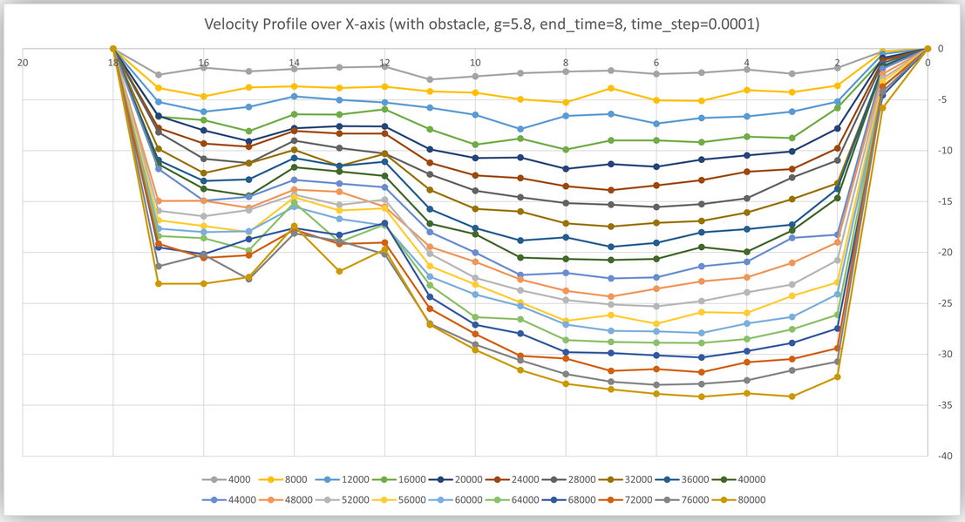
Nano-scale flow simulation
3
New features:
Fixed flag for particles
New thermostat interceptor
Simulations:
Unhindered flow
Cuboid obstacle
Spherical obstacle
High velocity

Slide 20
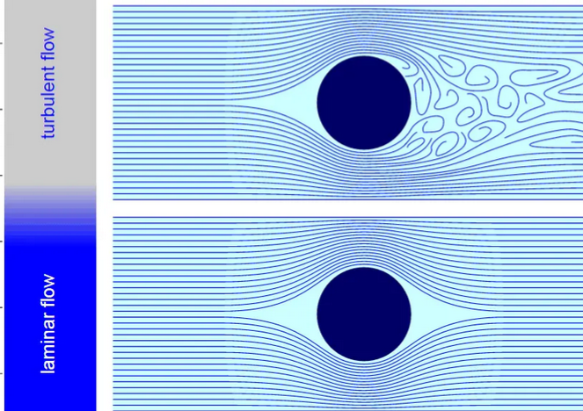
Nano-scale flow simulation
4
New features:
Fixed flag for particles
New thermostat interceptor
Simulations:
Unhindered flow
Cuboid obstacle
Spherical obstacle
High velocity
Full Video at:
https://manuellerchner.github.io/MolSim-WS23-24/submissions/#sheet05

Slide 21
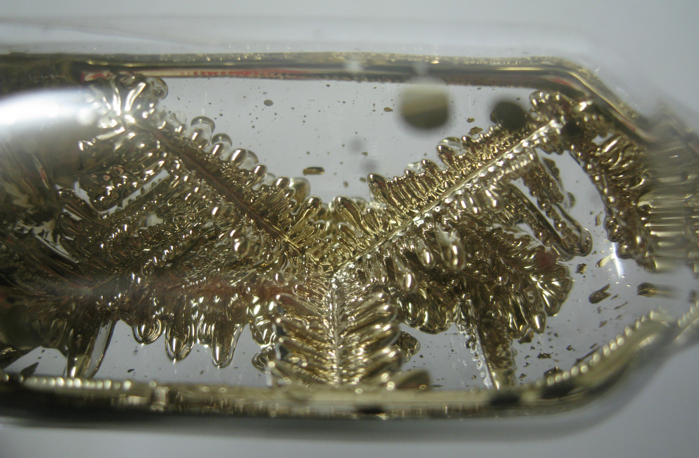
Crystalization of Argon
Implementation:
Smoothed Lennard Jones Potential
Measurements as Interceptors
Qualitative Analysis:
Energy is taken out of the system until the attractive LJ outweighs Temperature
Smaller and more holes in supercooled crystal

Slide 22
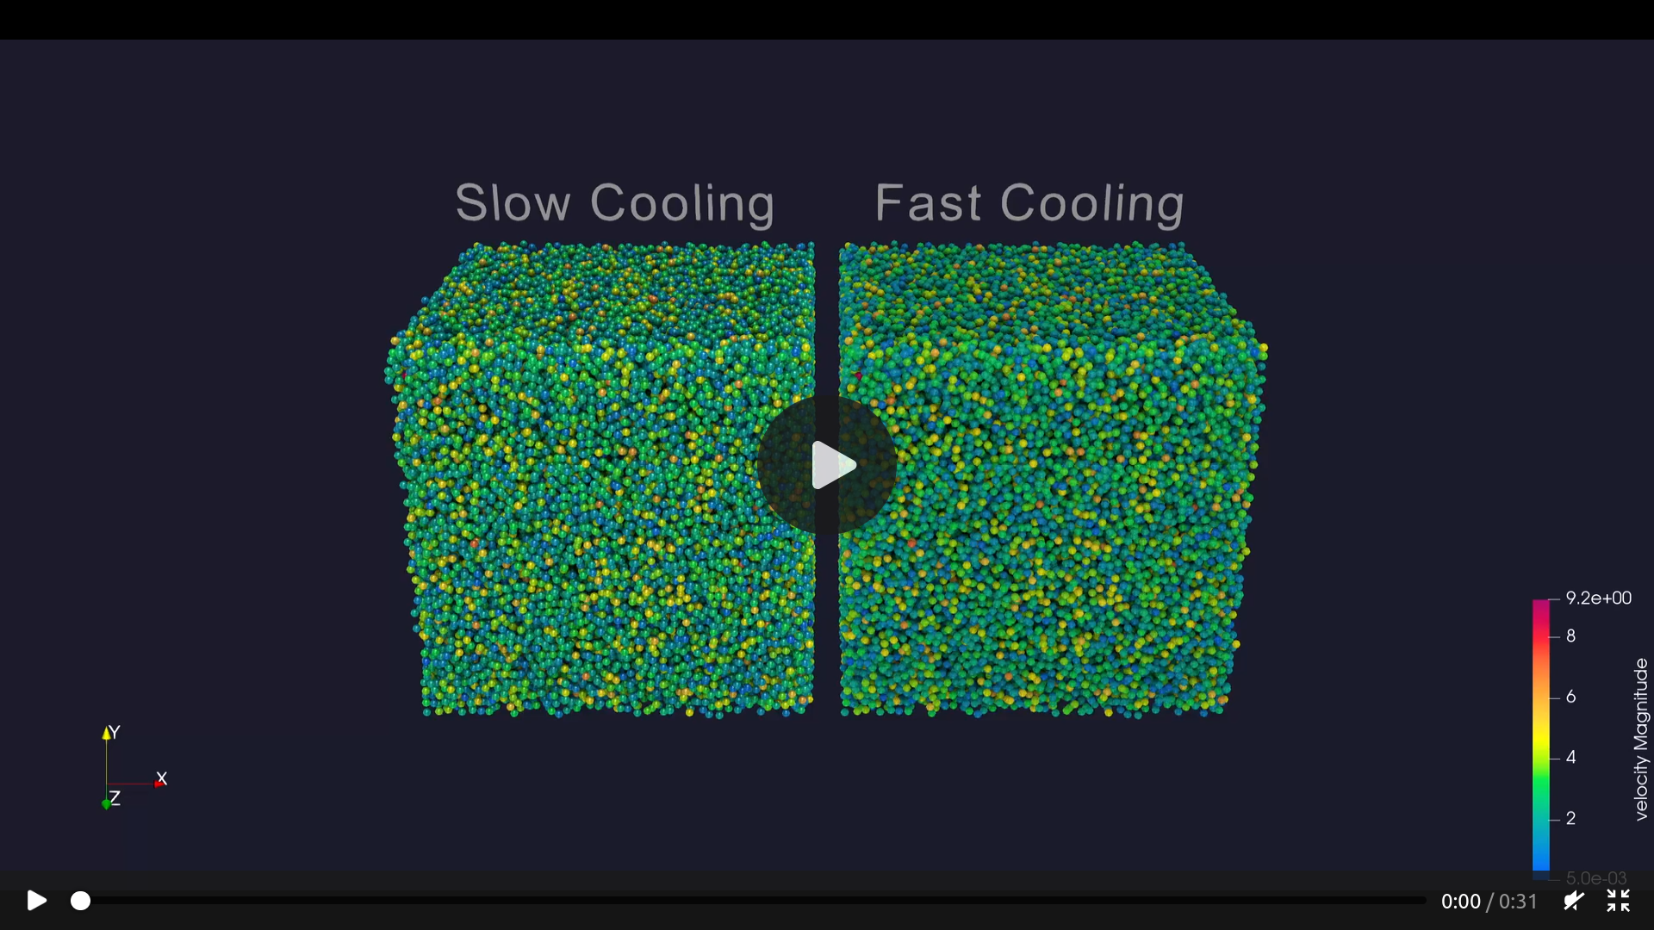
Crystalization of Argon
Full Video at:
https://manuellerchner.github.io/MolSim-WS23-24/submissions/#sheet05

Slide 23
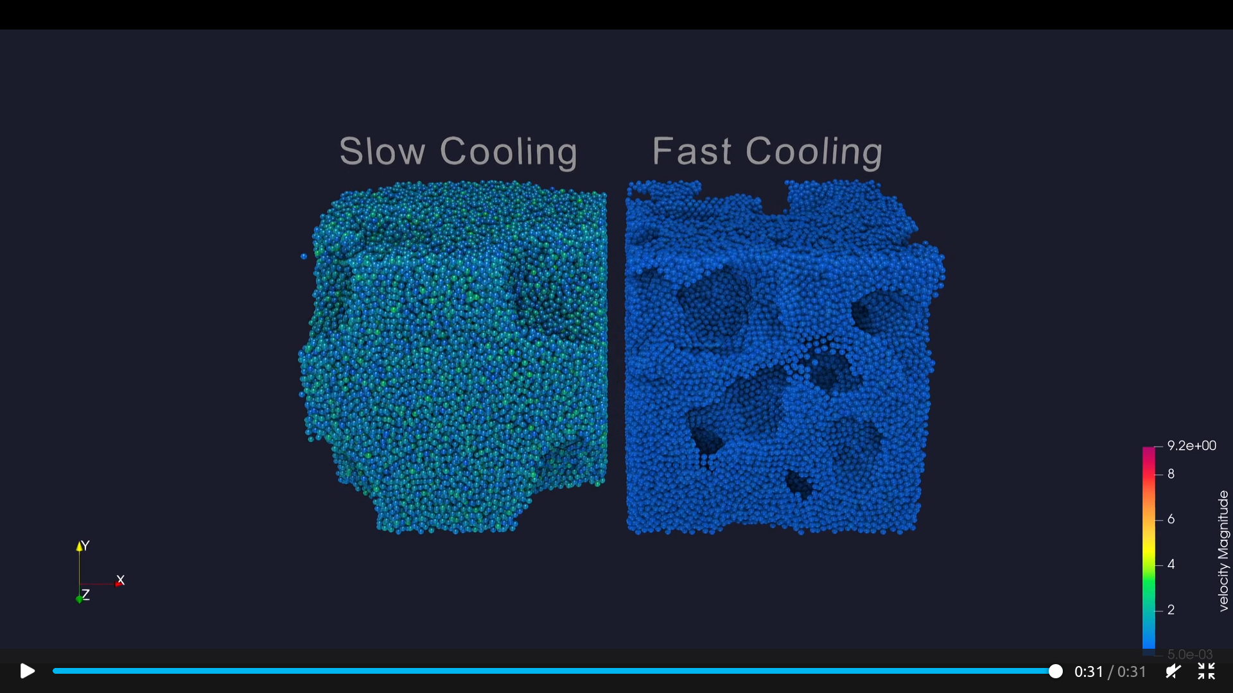
Crystalization of Argon
Full Video at:
https://manuellerchner.github.io/MolSim-WS23-24/submissions/#sheet05

Slide 24
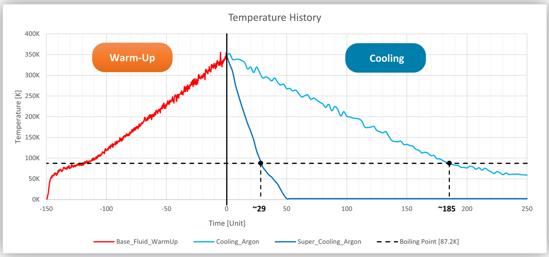
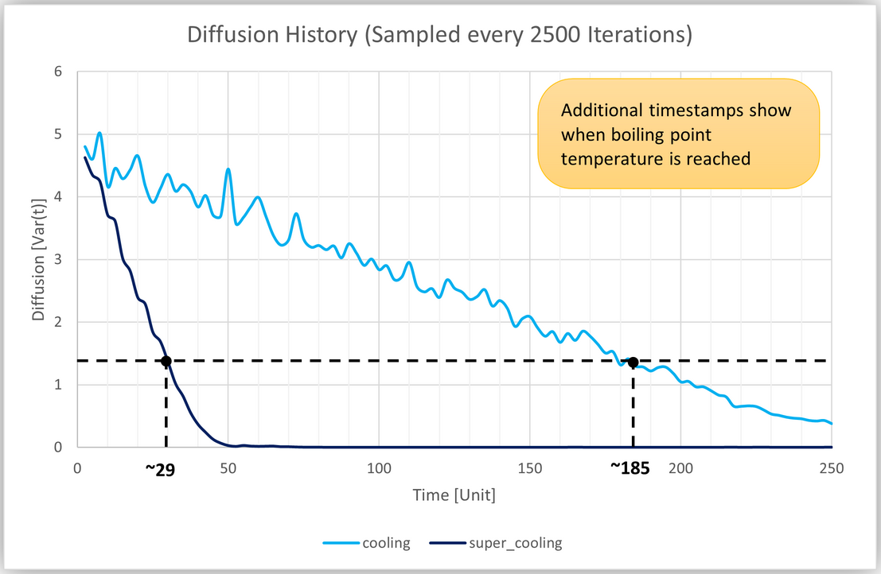
Crystalization of Argon
Quantitative Analysis:
Diffusion & Temperature History
Radial Distribution Function
Explanation:
Fast nucleation rate
Less time to distribute in space

Slide 25
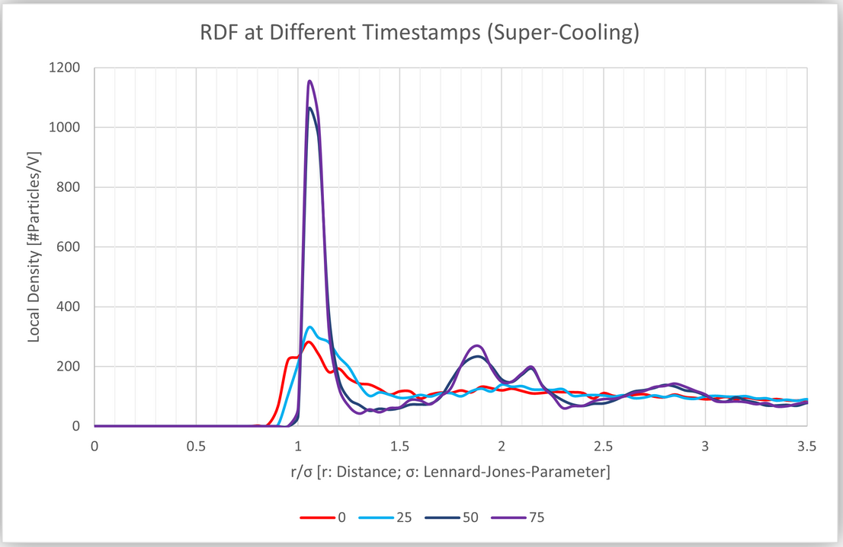
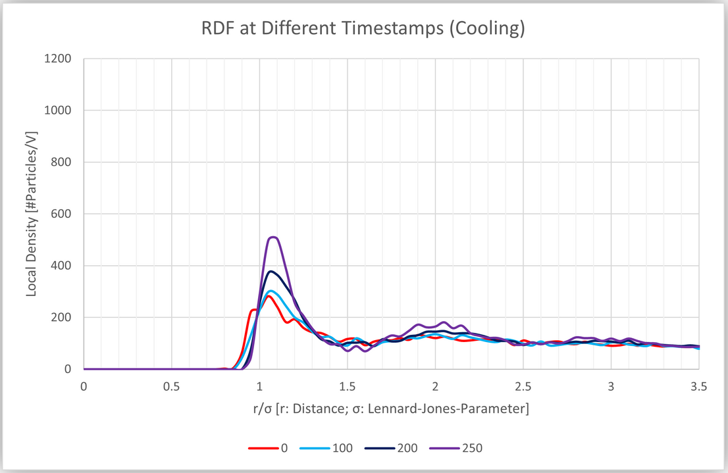
Crystalization of Argon
Quantitative Analysis:
Diffusion & Temperature History
Radial Distribution Function
Explanation:
Fast nucleation rate
Less time to distribute in space

Slide 26
Summary of cool things
We made a satisfying simulation of rubber cubes
We read a paper by Prof. Bungatz
We accelerated the simulation by threading
We observed unstable chaotic system
We analysed a particle flow on nano-scale
We ran hours of argon simulation

Slide 27
References
Waves: https://www.pinterest.de/pin/harmonic-waves-in-architecture-google-search-musicperformance-music-performance-architecture--690247080384012557/
Domain partitioning: https://www.researchgate.net/profile/Fabio-Gratl/publication/357143093_N_Ways_to_Simulate_Short-Range_Particle_Systems_Automated_Algorithm_Selection_with_the_Node-Level_Library_AutoPas/links/649acc9cc41fb852dd355f24/N-Ways-to-Simulate-Short-Range-Particle-Systems-Automated-Algorithm-Selection-with-the-Node-Level-Library-AutoPas.pdf
Threads: https://en.wikipedia.org/wiki/Thread_pool
Reynolds number https://www.nuclear-power.com/nuclear-engineering/fluid-dynamics/reynolds-number/reynolds-number-for-turbulent-flow/
Argon crystal https://en.wikipedia.org/wiki/Argon#/media/File:CsCrystals.JPG

